Slide 1
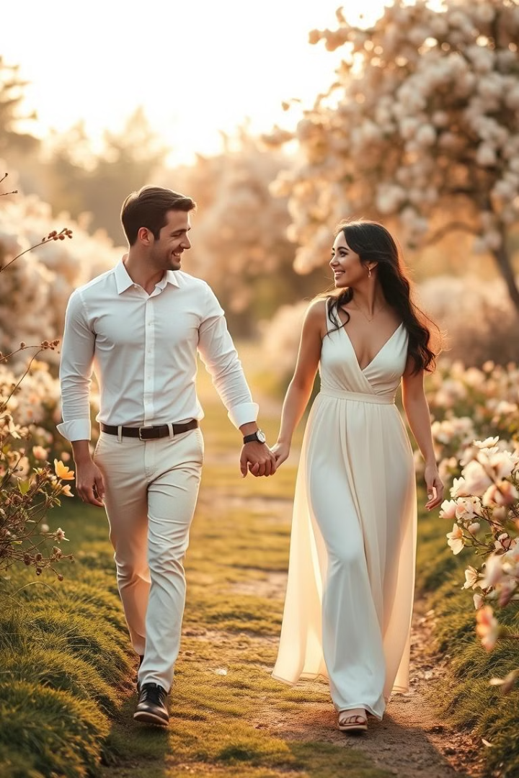
Unleash Your Romantic Side with Victoria's Secret Romantic Body Mist
This presentation outlines a comprehensive digital marketing campaign for Victoria's Secret Romantic Body Mist at Maxie, a department store in May Pen, Jamaica.

Slide 2
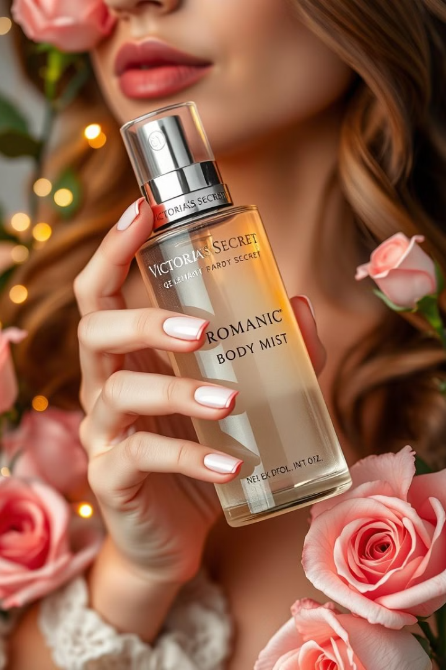
Project Overview
1
Goal
2
Target
Enhance brand visibility and drive traffic to Maxie.
Promote the romantic aura associated with the scent.
3
Strategy
4
Outcome
Implement a multi-channel digital marketing campaign.
Increase sales and establish Victoria's Secret as a leading fragrance brand in May Pen.

Slide 3
Target Audience
Demographics
Psychographics
Females aged 18-35
Beauty enthusiasts
Middle to upper-middle-class income
Active on social media
Seeking romantic gifts or personal use
Interested in unique and quality fragrances

Slide 4
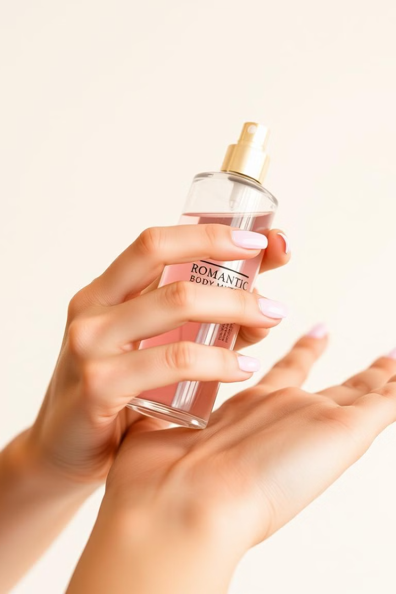
Campaign Objectives
Brand Recognition
In-store Sales
Establish Victoria's Secret as a leading romantic fragrance brand in May Pen.
Drive traffic to Maxie through promotions and special offers.
Engagement/Interaction
Generate hype on social media through engagement and in-store events.

Slide 5

Digital Advertising Strategy
Channel
Ad Copy
Keywords
Metrics
Google Ads
Ad Title: "Get Romantic at Maxie" Description: "Indulge in the enchanting Victoria's Secret Body Mist. Ideal for date nights or everyday allure! Only at Maxie, May Pen." Call to Action: "Visit Us Today"
VS Romantic Body Mist, best body sprays, fragrances for her, floral fragrance, gifts for her.
Target CTR: 4% Estimated Impressions: 2,00,000 within the first month. Expected Clicks: 8,000.

Slide 6
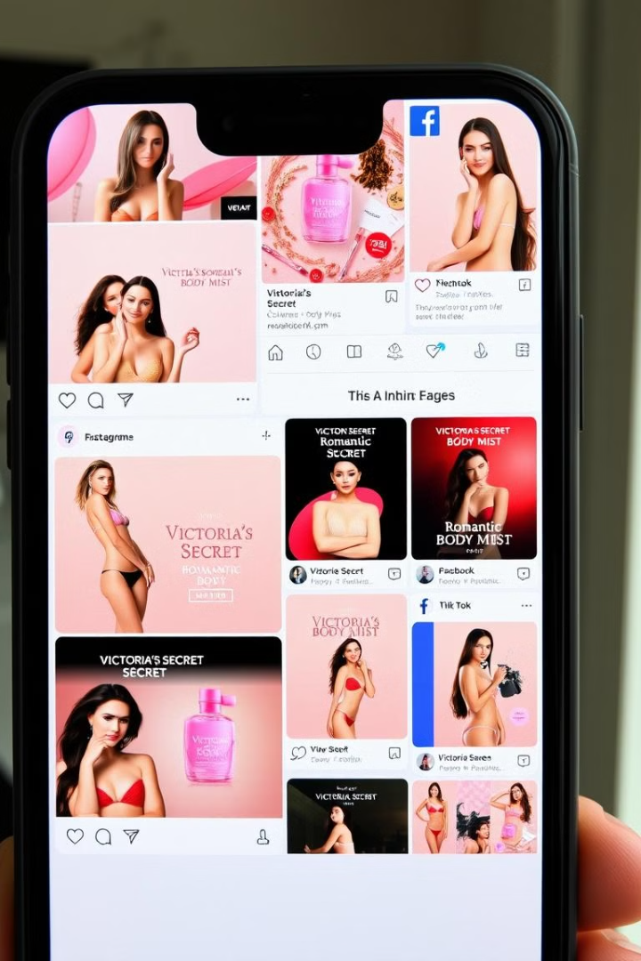
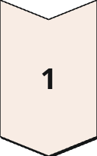
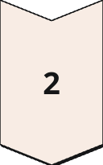
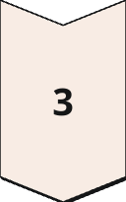
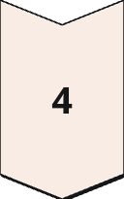
Social Media Ads
Instagram Ads
Beautiful images and short videos representing romance tied with the product.
Facebook Ads
Promotions and contests that encourage user engagement.
TikTok Ads
Short video clips featuring influencers trying the body mist and giving dating tips.
Twitter Ads
Special announcements and reminders of limited-time promotions.

Slide 7
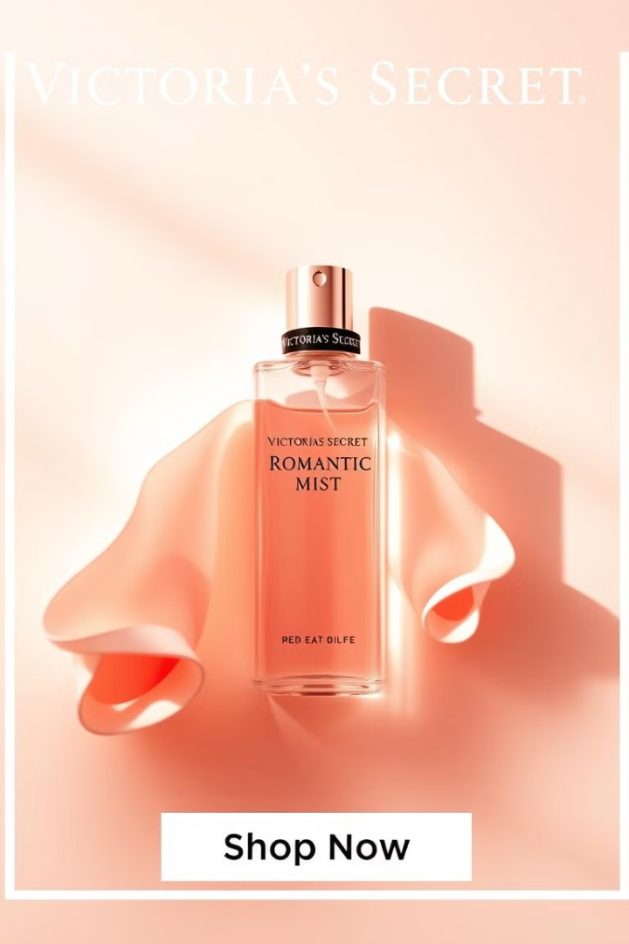
Banner Ads
Placement
Ad Copy
Dimensions
Metrics
Lifestyle and beauty websites, blogs, and online magazines
Banner Text: "Find Your Romance at Maxie" Image: Aesthetic shots of Romantic Body Mist against a rose background or with dimmed lighting.
728x90 (Leaderboard), 300x250 (Medium Rectangle), 300x600 (Half Page)
Target CTR: 0.75%. Estimated Impressions: 250,000 across selected websites. Expected Clicks: ~1,875.

Slide 8



Offline and In-Store Promotion
In-store Events
Promotional Display
Host a "Romantic Night" event at Maxie featuring free fragrance samples, complimentary gift wrapping, and mini workshops.
Place beautiful displays near the entrance and at the beauty area in Maxie to attract customers' attention.

Slide 9
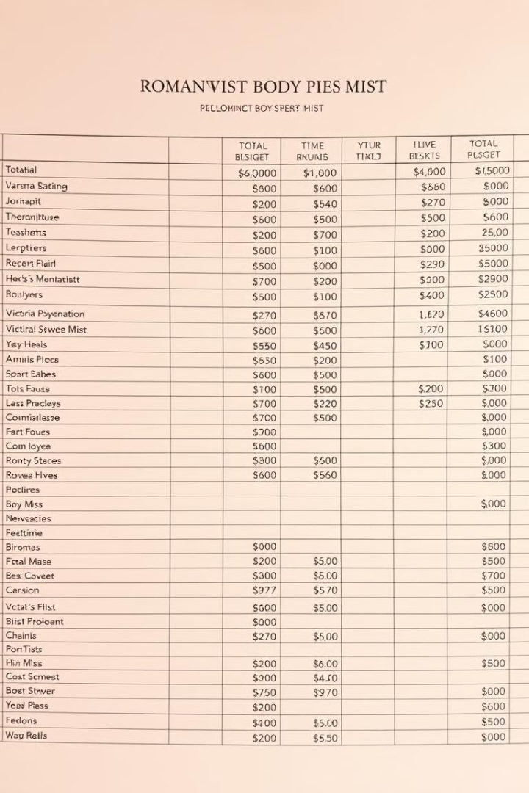
Budget Breakdown
Category
Budget
Total Budget
$15,000
Google Ads Budget
$3,000
Social Media Ads Budget
$6,000
Banner Ads Budget
$2,000
In-Store Event Budget
$4,000

Slide 10
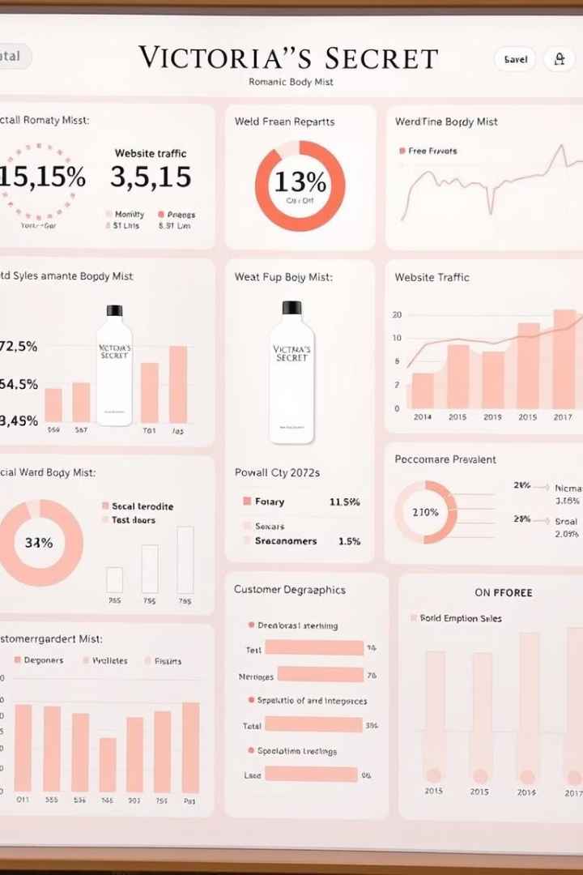
Measurement and KPIs
1
Total Sales
Track the total sales of Victoria's Secret Romantic Body Mist at Maxie during the campaign period.
2
Foot Traffic
Analyze foot traffic pre- and post-event, including at the in-store activity.
3
Social Media Engagement
Assess the success of the ads by analyzing the CTR, the impressions, and the number of clicks.

Slide 11
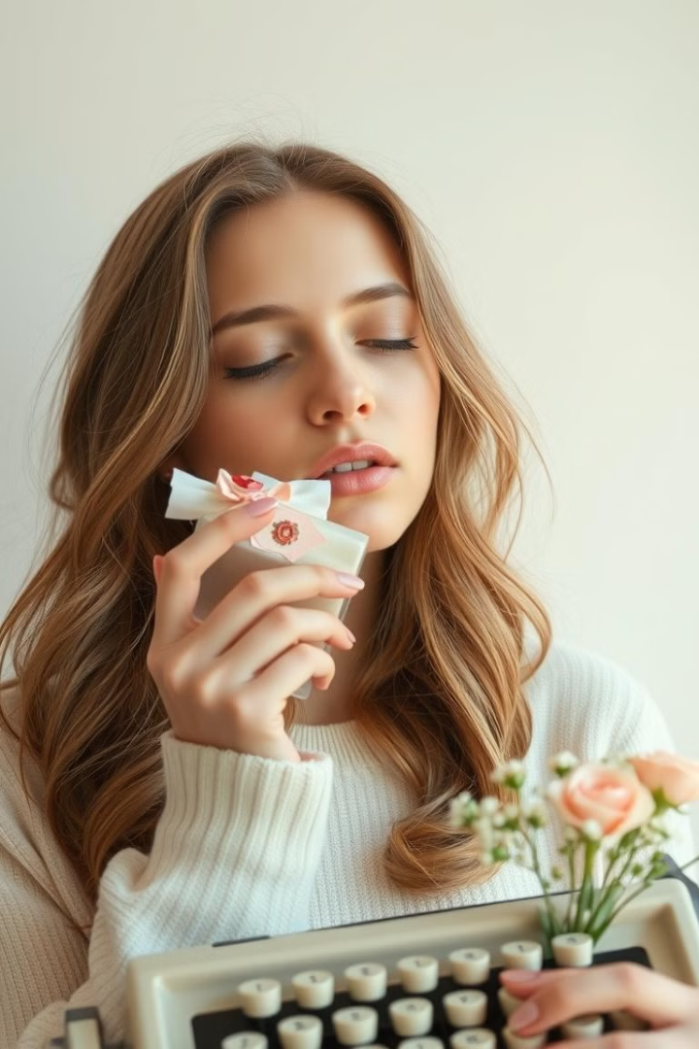
Successful Conclusion to a Memorable Campaign
This comprehensive advertising campaign for Victoria's Secret Romantic Body Mist at Maxie in May Pen is poised to deliver an impactful engagement with the target audience, strengthening the brand's presence and driving revenue in the local community.

